Slide 1

Bank personal Loan
Nicolas Veas

Slide 2
Objective
Context
Predicting if a customer will buy a personal loan or not has high importance to the bank, especially when it comes to marketing campaigns. If we know whether a customer will buy a loan or not, we can make better target marketing campaigns to increase success ratio.
In this project, I'll use classification model to predict customers' have higher probability of purchasing a loan.
The data used is from kaggle from the following link:
https://www.kaggle.com/datasets/mahnazarjmand/bank-personal-loan?resource=download
Build a model that will help to identify the potential customers who have a higher probability of purchasing a loan.
Predict whether a customer will buy a personal loan or not.

Slide 3
Data Information
5000 Observations
14 Variables
5 Numerical Variables
8 Categorical Variables
No missing values
No duplicated Values
Contains the following Variables
ID: Customer ID
Age: Customer’s age in completed year
Experience: #years of professional experience
Income: Annual income of the customer (in thousand dollars)
ZIP Code: Home Address ZIP code.
Family: the Family size of the customer
CCAvg: Average spending on credit cards per month (in thousand dollars)
Education: Education Level. 1: Undergrad; 2: Graduate;3: Advanced/Professional
Mortgage: Value of house mortgage if any. (in thousand dollars)
Personal Loan: Did this customer accept the personal loan offered in the last campaign?
Securities Account: Does the customer have securities account with the bank?
CD Account: Does the customer have a certificate of deposit (CD) account with the bank?
Online: Do customers use internet banking facilities?
CreditCard: Does the customer use a credit card issued by any other Bank (excluding All life Bank)?

Slide 4
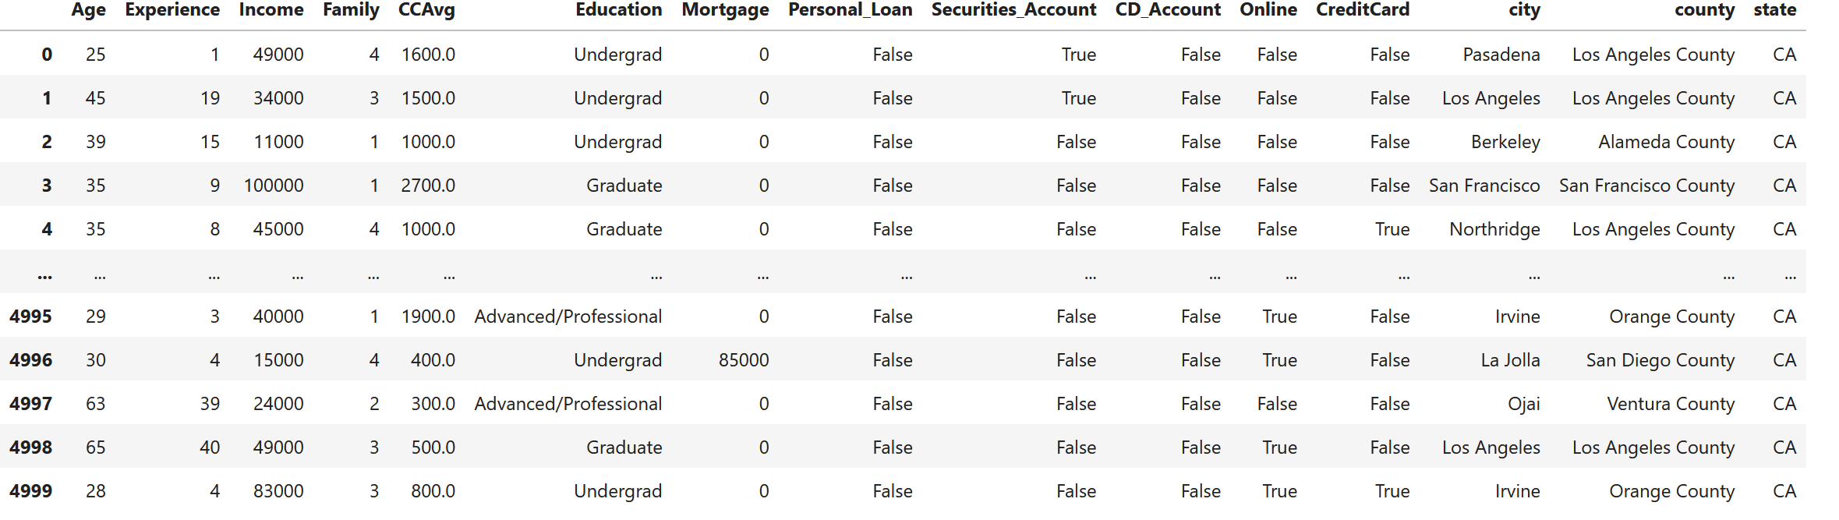
Exploratory data analysis
Data from 245 cities and 39 counties, Most of the customers are from Los Angeles County, around 21%
All data is from California
Customers age between 23 and 67 years old
Most customers don't have a Mortgage
Most customers are single
Over 2000 customers are Undergraduate
Only 480 customers out of 5000 had Personal Loan (around 10%)
Most customers have online usage
4478 customers don't have a Securities account, ~10% have it
4478 customers don't have CD accounts, ~10% have it
3530 customers don't have Credit Cards in another bank, ~30% have it

Slide 5
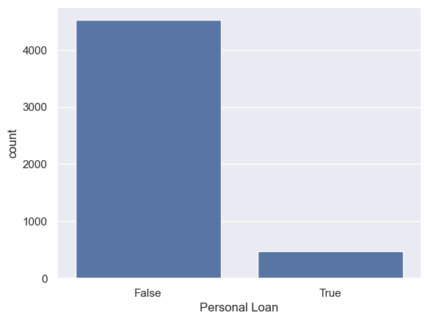
Exploratory data analysis TARGET VARIABLE Variable - Personal_Loan
* 90.4% of customers didn't accept personal loan on the previous campaign
* 9.6% accepted personal loan on the previous campaign

Slide 6
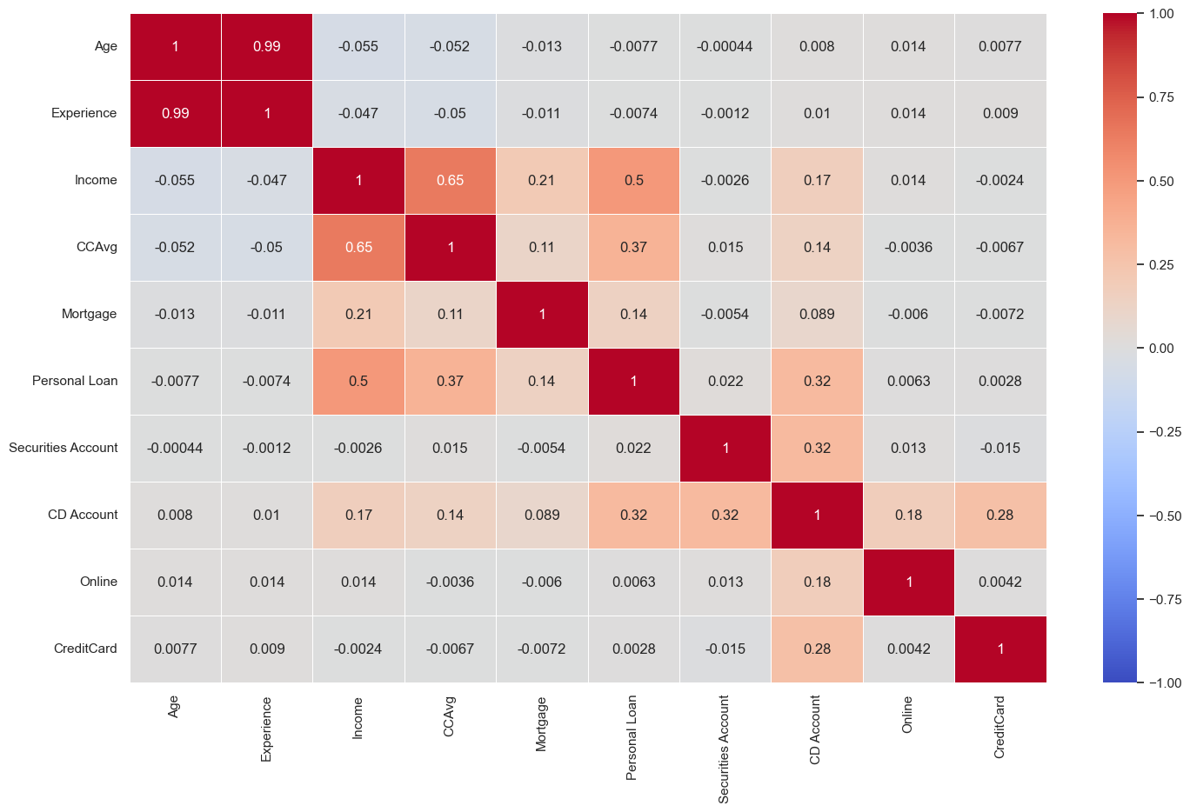
Exploratory data analysis Correlation heatmap
Personal loan is most correlated with Income
Age and experience are highly correlated (.99), as we can expect.

Slide 7
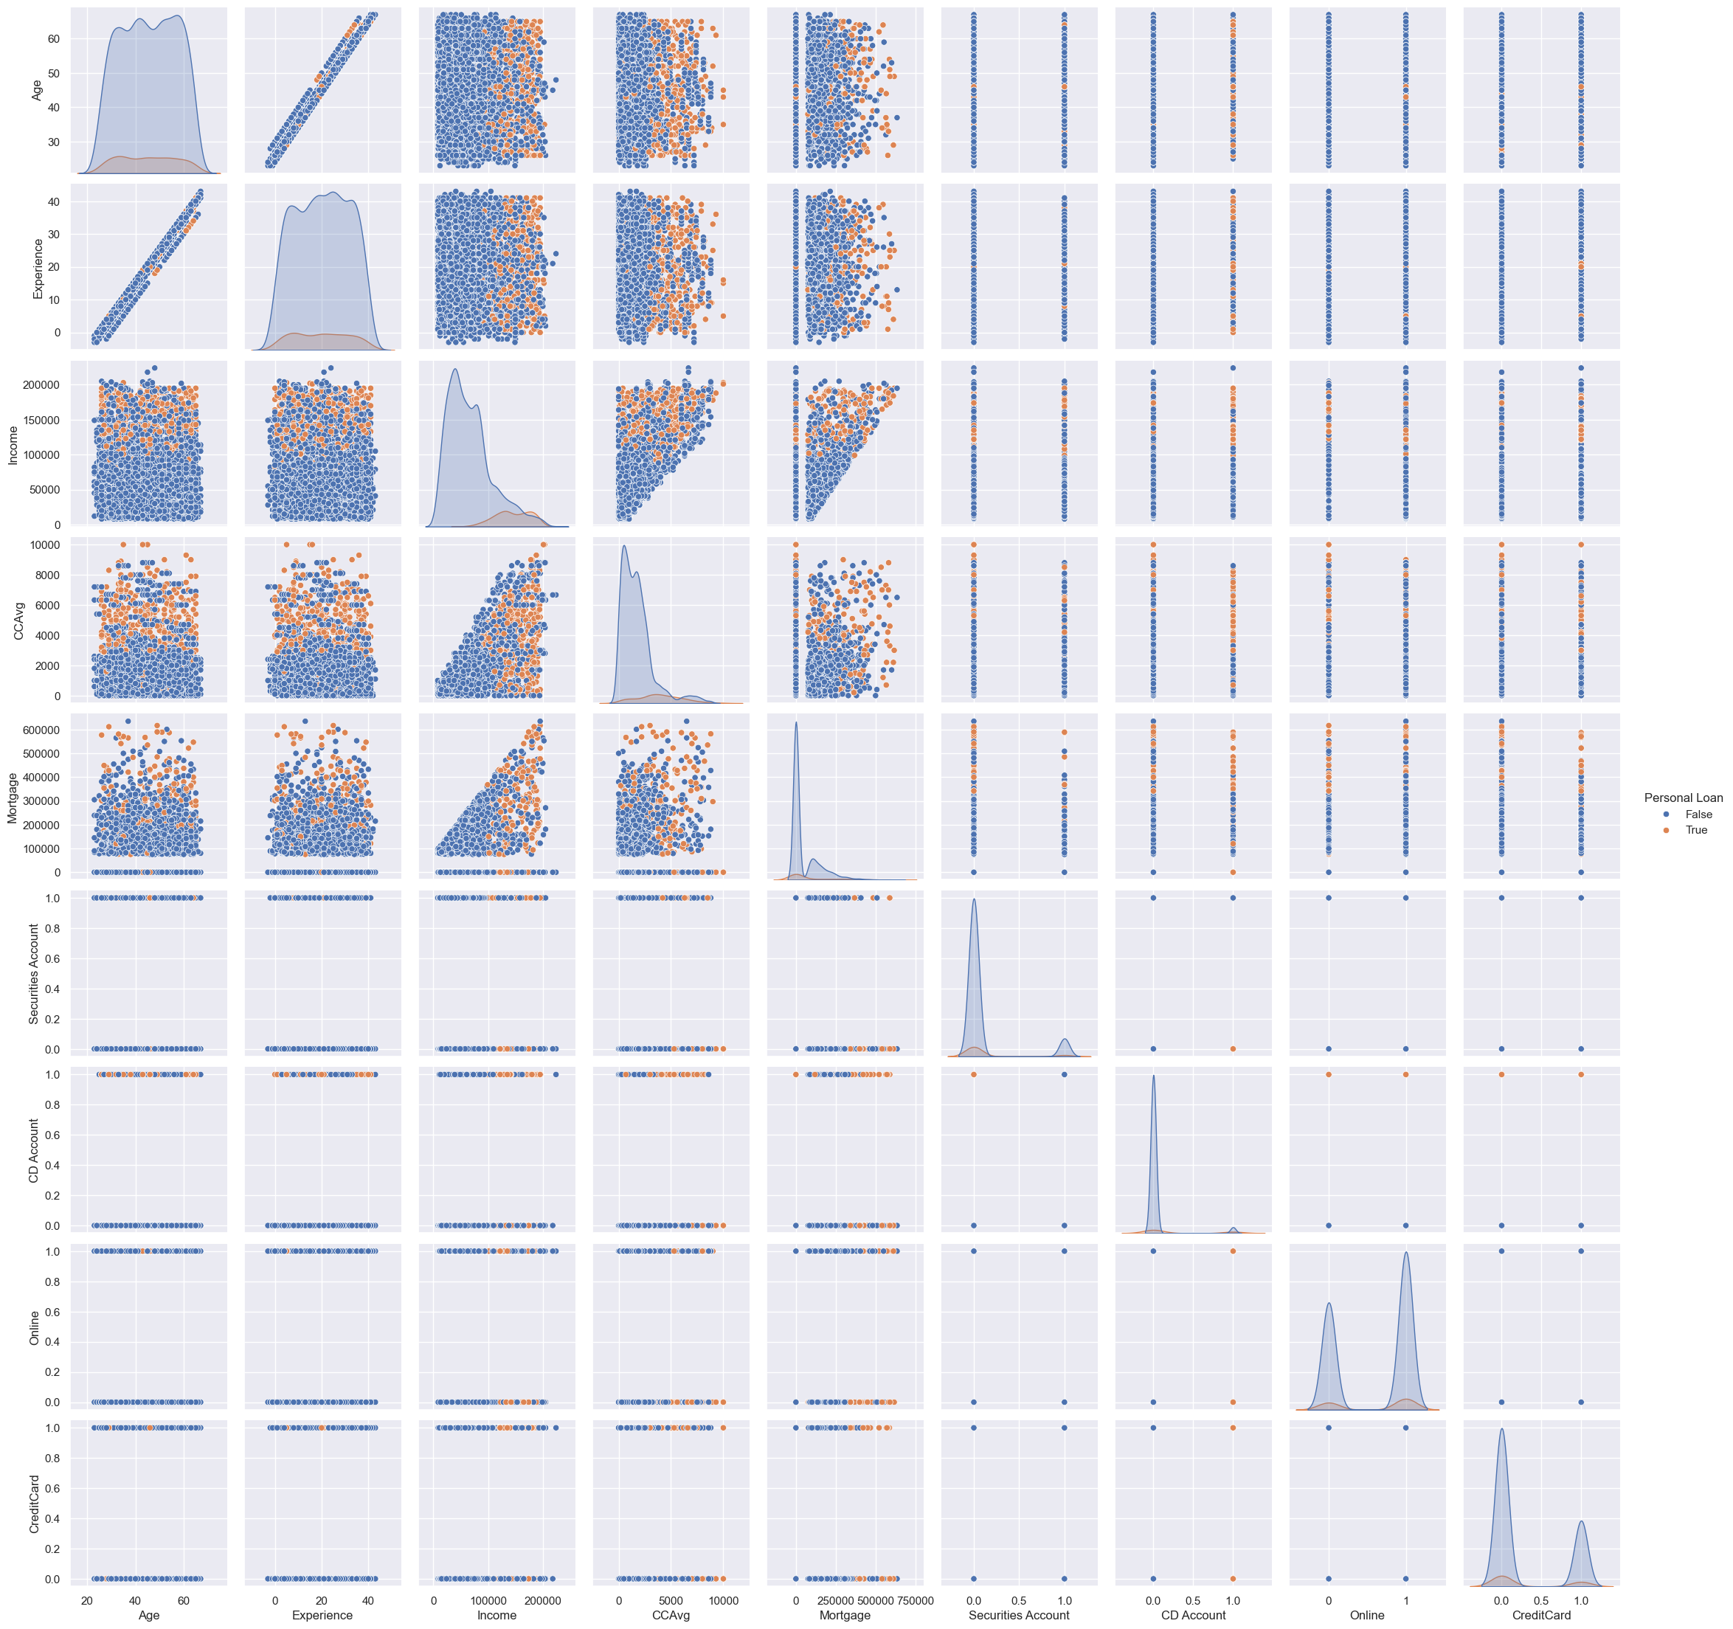
Exploratory data analysis Scatter plot
We can see the linear correlation between Experience and Age
People with high incomes get more loans than the rest.
People with high credit card usage also trends to gem more loans.

Slide 8
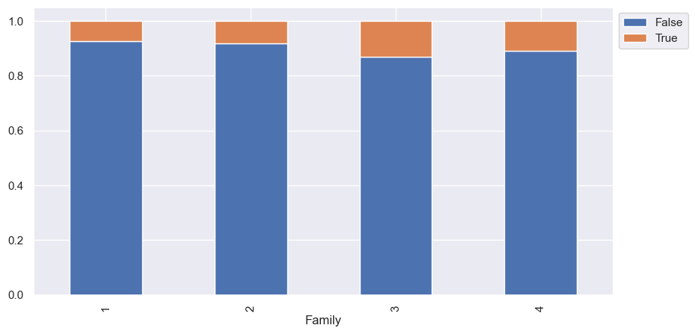
Exploratory data analysis Categoricals
Personal loans are given more to families of 3 and 4 children.

Slide 9
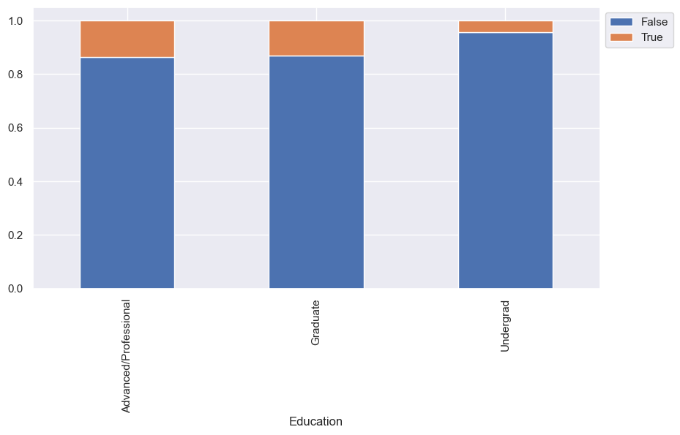
Exploratory data analysis Categoricals
Personal loans were given more to customer graduated and andvanced/professional

Slide 10
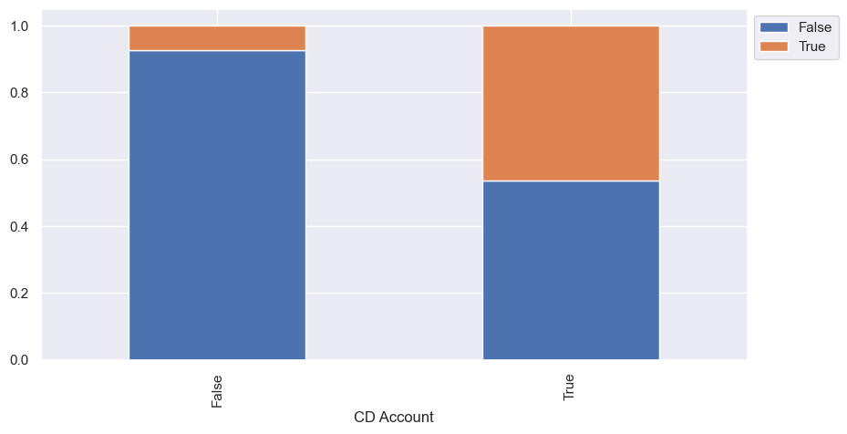
Exploratory data analysis Categoricals
Around 45% of the people with CD Account got Personal Loan

Slide 11
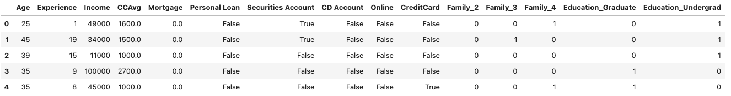
Model Building Data Preparation
We want to optimize recall, as we like to get as less false positives as possible. the marketing campaings should aim to the most of potential loan buyers as possible.
Zipcode and ID Removed
Personal loan is our Target variable
Data Divided into 70% for training and 30% for testing
Converted categorical into dummy variables for modeling purposes

Slide 12
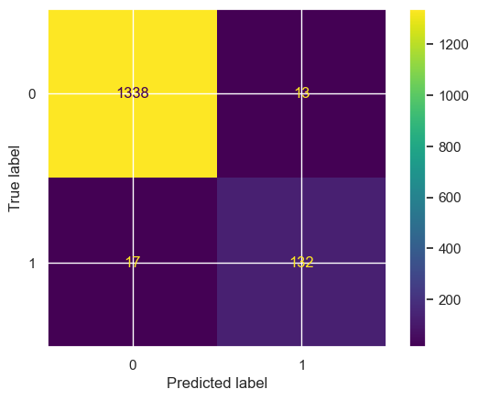
Model Building Logistic Regression
Used Skleanr
Best threshold for the model:
0.081
The model is not overfitted
We get a recall of 92.62%
The 5 most important features for this model are 'Experience', 'Income', 'Securities_Account', 'CD_Account', 'Online'

Slide 13
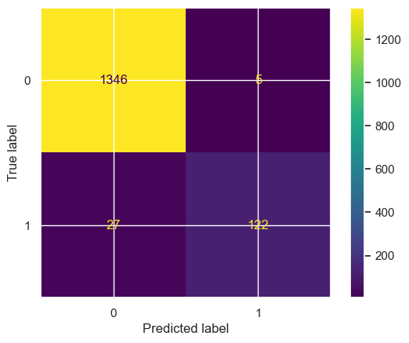
Model Building Decision Tree
Used GridSearchCV
Cpp_alpha 0.001
Criterion entropy
Max_depth 11
Min_samples_leaf 4
Min samples_split 2
Recall on training set : 0.925
Recall on test set : 0.82
It suggest the model is overfitted

Slide 14

Model Building RANDOM FORES
Used GridSearchCV
max_depth=20,
max_features="sqrt",
min_samples_leaf=1,
n_estimators=20
Recall on training set : 0.99
Recall on test set : 0.82
It suggest the model is overfitted

Slide 15
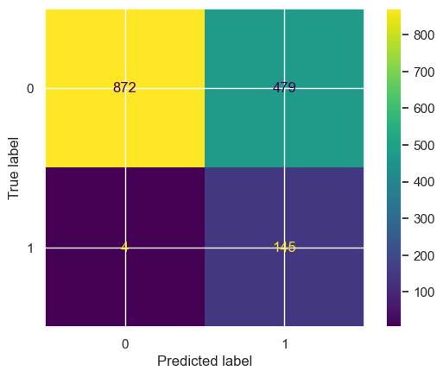
Model Building ADA BOOST
Used GridSearchCV
learning_rate=2
n_estimators=10
Recall on training set : 0.98
Recall on test set : 0.9732

Slide 16
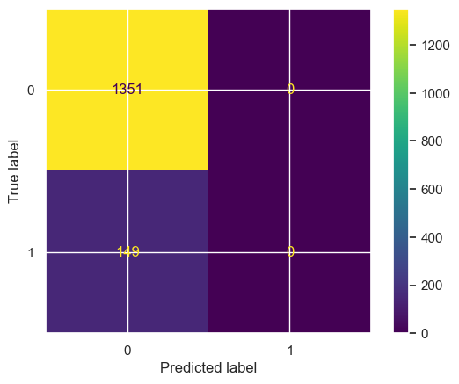
Model Building VECTOR MACHINE
Used GridSearchCV
C=0.03125,
gamma=0.03125,
kernel="rbf"
Recall on training set : 0
Recall on test set : 0

Slide 17
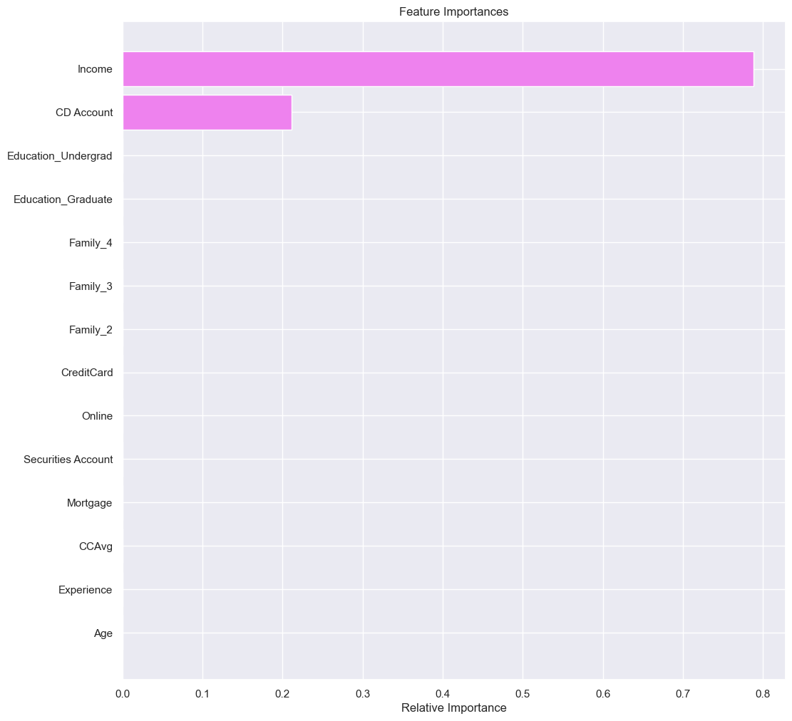
RESUMEN
Recall Logistic Regression optimized: 0.9261744966442953
Recall Decision Tree optimized: 0.8187919463087249
Recall Random Forest optimized: 0.8187919463087249
Recall AdaBoost optimized: 0.9731543624161074
Recall SVM optimized: 0.0

Slide 18
Conclusions
We chose the AdaBoost model as our best model for this project.
Customers with high income >$100,000 are more likely to get a personal loan
Customers with credit card usage over $2,000 are more likely to get a personal loan
Customers with mortgages under $200,000 are more likely to get a personal loan

